Slide 1
ALT
(24ALT3101)
Spam SMS Detection
Group: 15
Sec: 07
2420030044 - U. Jaya Sindhura
2420030376 - K. Ushasri
2420030583 - P. Smitha

Slide 2

Introduction
SMS is widely used for communication, alerts, transactions, and promotions.
Spam messages may contain:
  Phishing attempts
  Fraudulent offers
  Malicious links
  Unwanted advertisements
Automatic spam detection is important for filtering unwanted and potentially harmful messages.
Different SMS messages contain different types of useful textual evidence.

Slide 3

Problem Statement
Problem
Traditional spam detection methods often use fixed features or representations.
They may not effectively capture:
Semantic meaning
Local textual patterns
Contextual information
Therefore:
A system is required that can adaptively combine different types of evidence for each SMS message.

Slide 4

Objectives
Develop a Transformer-based SMS spam detection system.
Use DistilBERT for contextual text representation.
Extract multiple forms of evidence from SMS messages.
Use Semantic, Pattern, and Context Experts.
Introduce a Dynamic Evidence Router.
Perform Dynamic Weighted Evidence Fusion.
Classify messages as SPAM or HAM.
Evaluate the model using standard classification metrics.
Perform ablation and robustness testing.

Slide 5
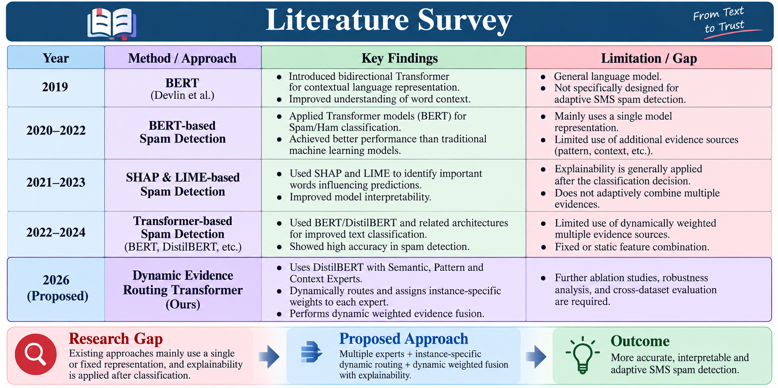
Literature Survey

Slide 6
Proposed Model
Dynamic Evidence Routing Transformer
The proposed model consists of:
DistilBERT Encoder
Semantic Expert
Pattern Expert
Context Expert
Dynamic Evidence Router
Dynamic Weighted Evidence Fusion
Classification Layer

Slide 7
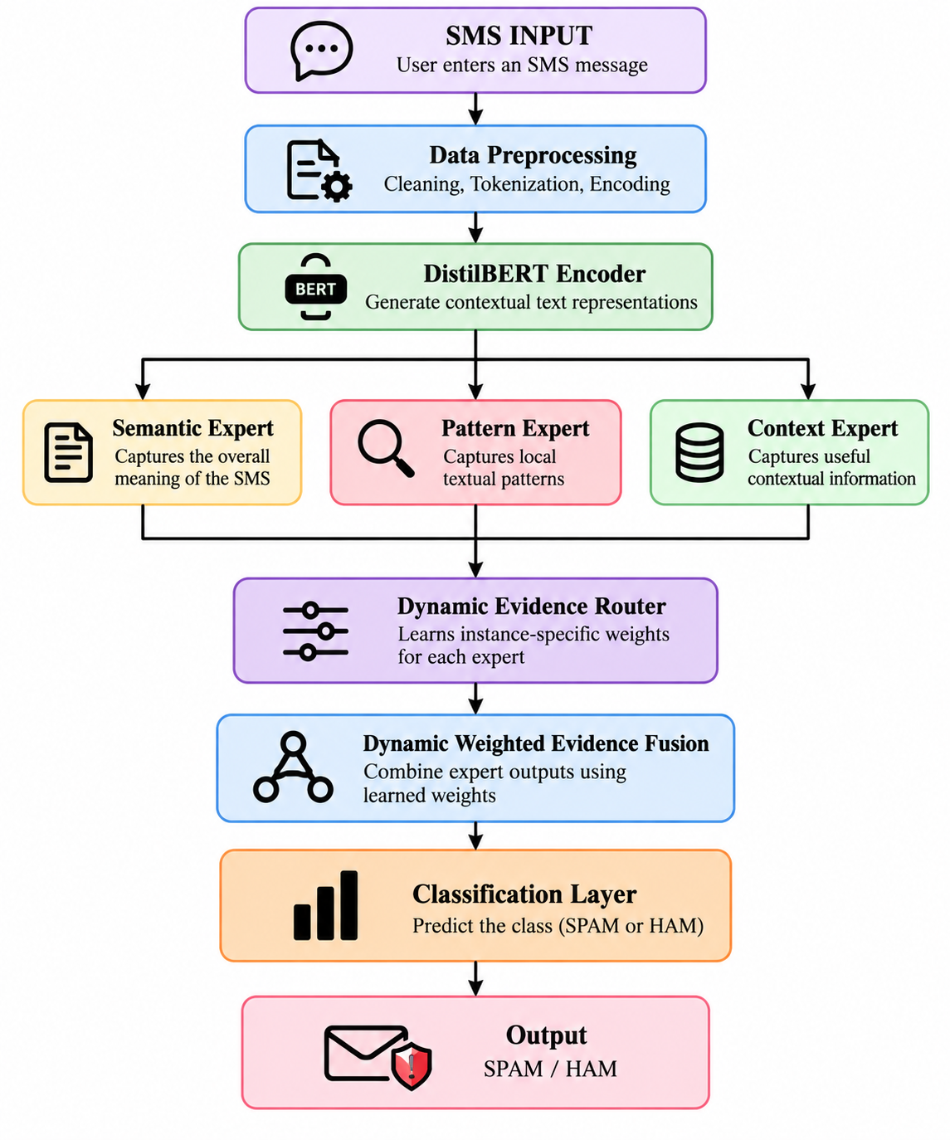
Diagram

Slide 8
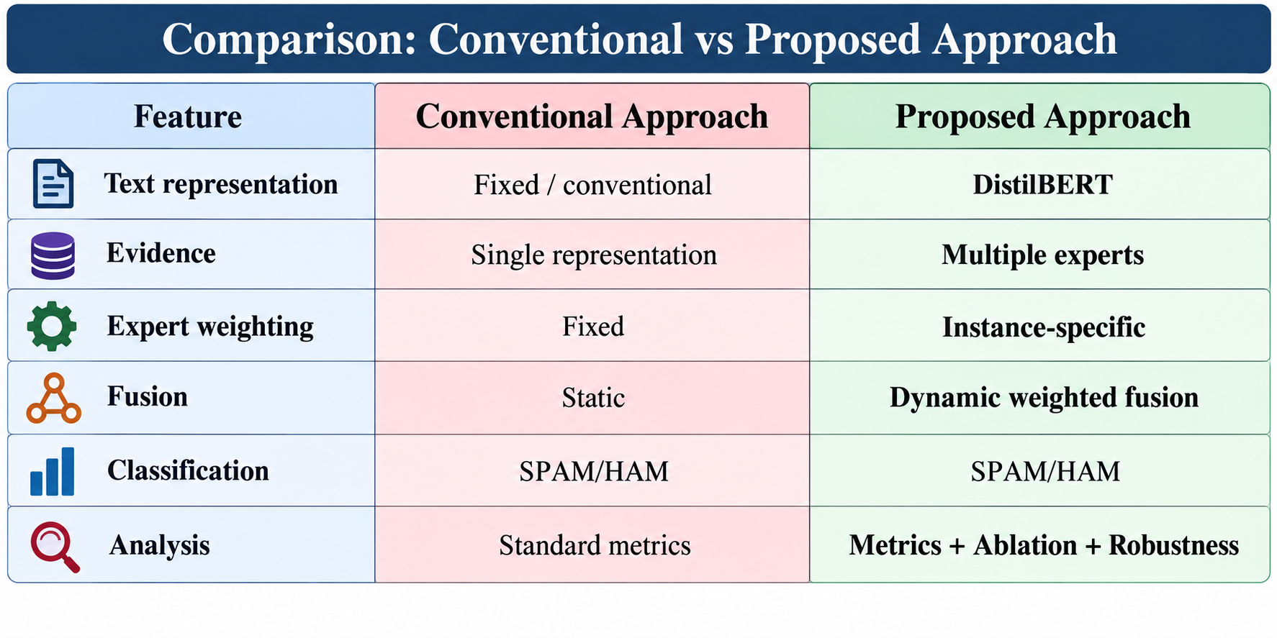
Comparison

Slide 9
Model Components
DistilBERT Encoder
Generates contextual representations of SMS text.
Semantic Expert
Captures the overall meaning of the message.
Pattern Expert
Captures important local textual patterns.
Context Expert
Captures useful contextual information.
Dynamic Evidence Router
Learns instance-specific weights for each expert.

Slide 10
Implementation Workflow/Output
SMS Dataset
↓
Data Preprocessing
↓
Train / Validation / Test Split
↓
DistilBERT Encoding
↓
Three Expert Branches
↓
Dynamic Evidence Router
↓
Dynamic Weighted Evidence Fusion
↓
Classification
↓
SPAM / HAM
Model trained successfully
Validation performed
Best model checkpoint saved
Test evaluation performed

Slide 11
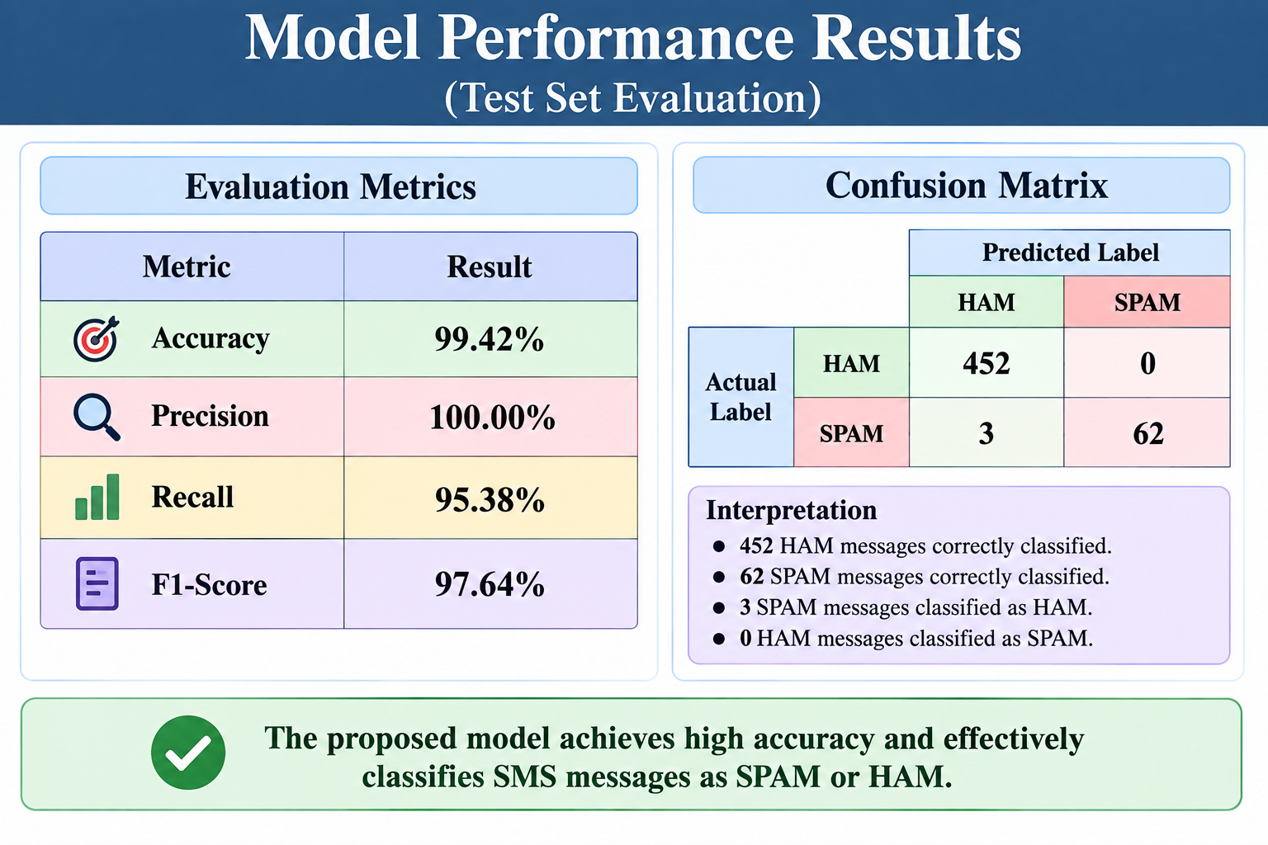
Execution Results

Slide 12
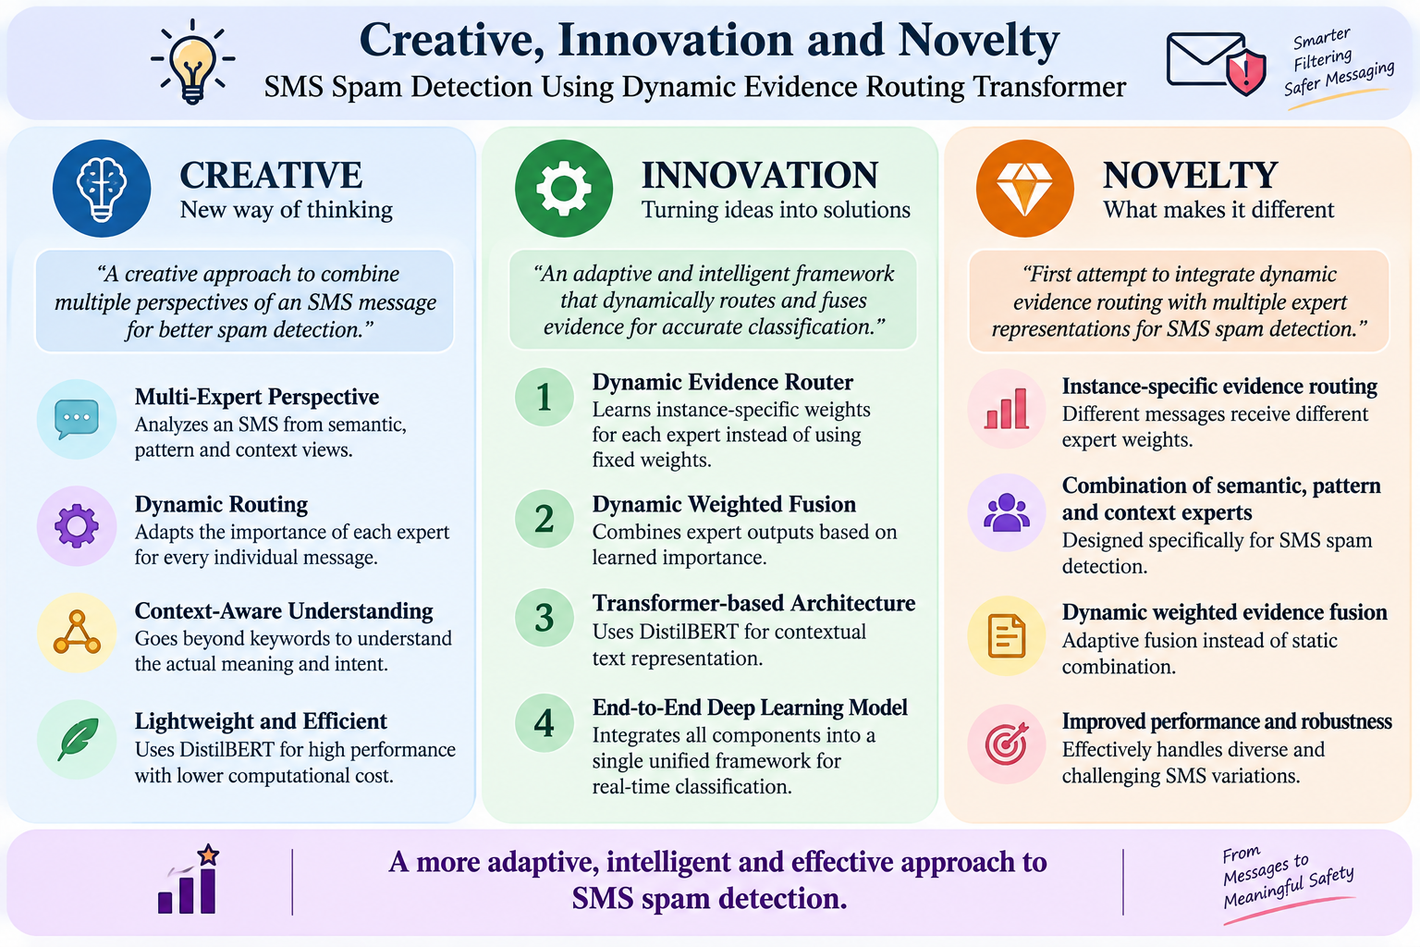
Innovation&Novelty

Slide 13
Conclusion
Implemented a Dynamic Evidence Routing Transformer for SMS spam detection.
Uses DistilBERT with Semantic, Pattern, and Context Experts.
Dynamic Evidence Router learns instance-specific expert weights.
Dynamic Weighted Evidence Fusion combines the expert outputs.
Current test performance:
  99.42% Accuracy
  97.64% F1-Score

Slide 14
Future Scope
Complete ablation experiments.
Perform extensive robustness testing.
Evaluate on additional SMS datasets.
Improve dynamic routing.
Explore lightweight deployment.
Test on larger and more diverse SMS datasets.

Slide 15
Thank you

